Slide 1
STUDENT RESULT SYSTEM
Using C++ • Object-Oriented Programming
CAPSTONE PROJECT – REVIEW
B.Kusula(25B11CS081)
A.Varshini(25B11CS071
B.Meghana(25B11CS109)
B.Hemanth(25B11CS123)

Slide 2
Project Overview
A practical C++ solution for managing student academic records.
STUDENT DATA
ACADEMIC DATA
RESULT PROCESSING
Student ID • Name • Department • Semester
Five subject marks • Total • Percentage
Grade • Pass / Fail
SEARCH
SORTING
PERSISTENCE
Search by Student ID or Name
Sort records by ID or Name
Save and load using students.txt
MENU-DRIVEN CONSOLE APPLICATION

Slide 3
Problem Statement
Why is a dedicated student result system needed?
• Managing student marks manually can be time-consuming.
• Manual calculation of total and percentage may lead to errors.
• Finding a particular student becomes difficult as records increase.
• Maintaining student information in separate records is inconvenient.
• Repeated result calculations require additional effort.
• Student records need organized and persistent storage.

Slide 4
Project Objectives
What the system is designed to achieve.
01 MANAGE
02 RECORD
03 CALCULATE
Store and manage student academic information.
Maintain student details and subject-wise marks.
Automatically calculate total and percentage.
04 EVALUATE
05 SEARCH
06 APPLY C++
Determine grade and Pass/Fail status.
Find records using Student ID or Name.
Demonstrate OOP and C++ concepts.

Slide 5
Implemented Modules
Core functional modules implemented in the project.
STUDENT MODULE
MARKS MODULE
RESULT MODULE
Add Student
Update Student Details
Display Information
Enter Subject Marks
Validate 0–100
Update Marks
Calculate Total
Percentage
Grade • Pass/Fail
SEARCH MODULE
SORT MODULE
FILE MODULE
Search by ID
Search by Name
Sort by Student ID
Sort by Student Name
Save Records
Load Records
students.txt

Slide 6
System Workflow
Step-by-step execution flow of the application.
1 LOAD RECORDS
2 DISPLAY MENU
3 SELECT
4 VALIDATE
5 PROCESS
Read existing records
Show operations
User chooses option
Check input
Calculate result
6 DISPLAY
7 SEARCH / SORT
8 SAVE
9 RETURN
10 EXIT
Show output
Manage records
Store changes
Continue
Save and close

Slide 7
Object-Oriented Design
The project uses one user-defined class: Student.
CLASS 1 — Student
OBJECT
Represents a complete student record.
DATA MEMBERS
• studentID
• name / department / semester
• marks[5]
• total / percentage
• grade / result
BEHAVIOR
• Add • Enter marks • Calculate
• Display • Update • Save / Load
Student student;
ENCAPSULATION
Student data and operations are grouped inside the Student class using private data members and public member functions.

Slide 8
C++ Concepts Used
Programming concepts demonstrated by the implementation.
OOP
DATA STRUCTURES
PROGRAMMING
Classes & Objects
Encapsulation
Constructor
Member Functions
Arrays
vector<Student>
Strings
Loops
Conditions
switch-case
Functions
STL
FILE HANDLING
vector
sort()
Algorithms
ifstream
ofstream
File Reading / Writing

Slide 9
Key Implementation
Important implementation blocks from the project.
ADD STUDENT
RESULT CALCULATION
Student student;
student.addStudent();
student.enterMarks();
student.calculateResult();
students.push_back(student);
total = 0;
for (int i = 0; i < 5; i++)
total += marks[i];
percentage = total / 5.0;
Creates a student object, accepts details and marks, calculates the result and stores it.
The system calculates the total and percentage from five subject marks.

Slide 10
Result Processing
Automatic evaluation of total, percentage, grade and Pass/Fail.
TOTAL
PERCENTAGE
PASS / FAIL
Sum of 5 subject marks
Total ÷ 5
Any subject < 40 → FAIL
PERCENTAGE
GRADE
90 and above
A+
80 – 89
A
70 – 79
B
60 – 69
C
50 – 59
D
Below 50
E
Any subject < 40
F

Slide 11
Search & Sorting Features
Efficient retrieval and organization of student records.
SEARCH BY STUDENT ID
SEARCH BY NAME
searchByID(students);
Finds and displays a matching student record.
searchByName(students);
Finds matching records by name.
SORT BY ID
SORT BY NAME
sortByID(students);
Arranges records according to Student ID.
sortByName(students);
Arranges records alphabetically by name.

Slide 12
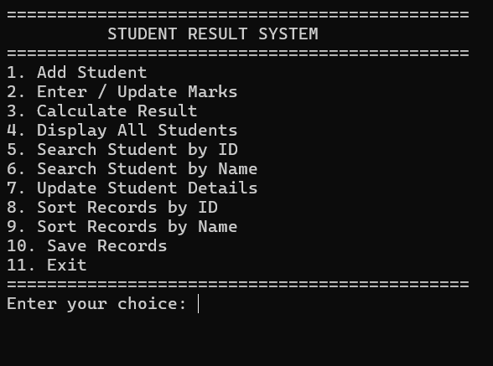
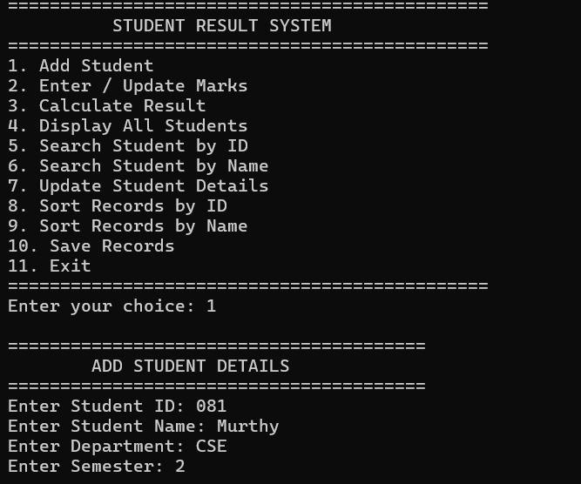
Final Output & Demonstration
ADD STUDENT
MAIN MENU
ENTER MARKS

Slide 13
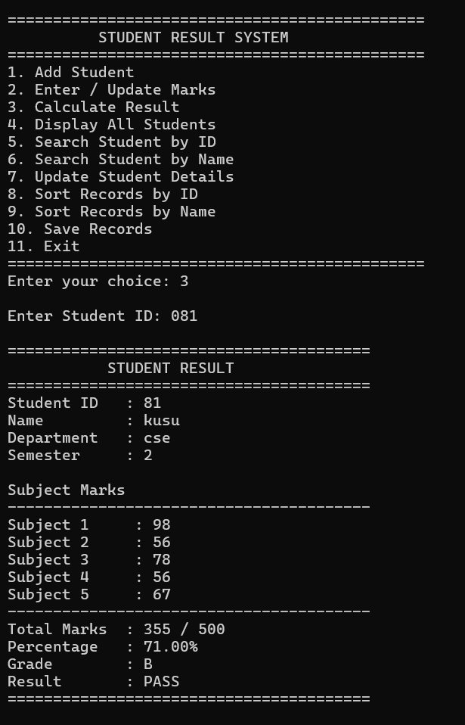
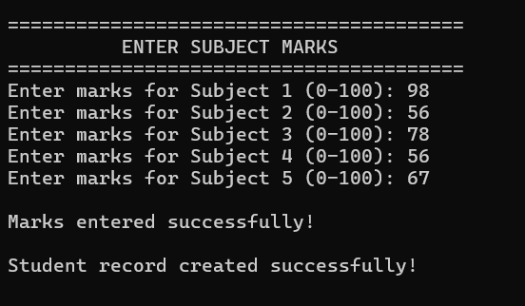
STUDENT RESULT
ENTER MARKS

Slide 14
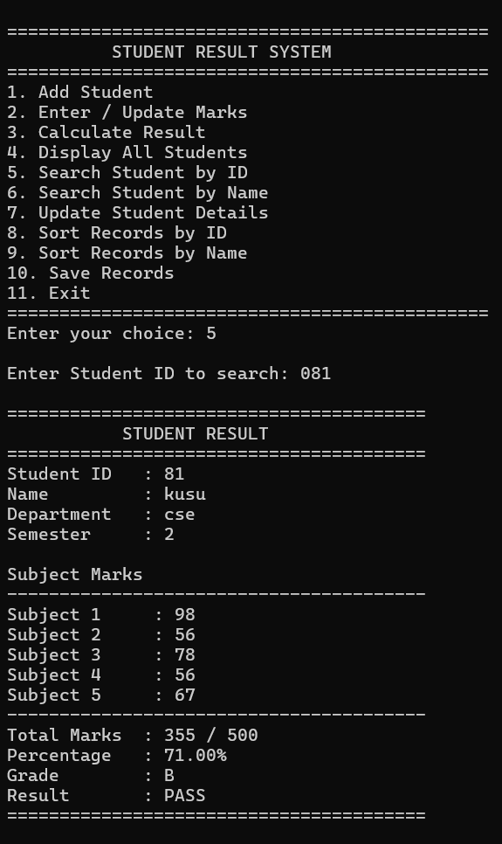
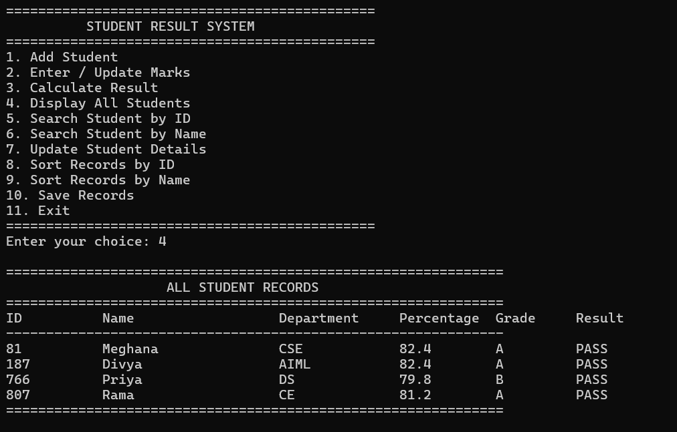
SEARCH RECORD
ALL STUDENT RECORDS

Slide 15
Final Implementation Status
Current project capabilities.
STUDENT MANAGEMENT
MARKS MANAGEMENT
Student details can be added and updated.
Five subject marks can be entered and validated.
RESULT PROCESSING
SEARCH & SORT
Total, percentage, grade and Pass/Fail are calculated.
Records can be searched and sorted by ID/name.
FILE MANAGEMENT
C++ CONCEPTS
Records are saved and loaded using students.txt.
OOP, arrays, vectors, functions, STL and file handling.
SUCCESSFULLY IMPLEMENTED

Slide 16
Thank You

